Slide 1
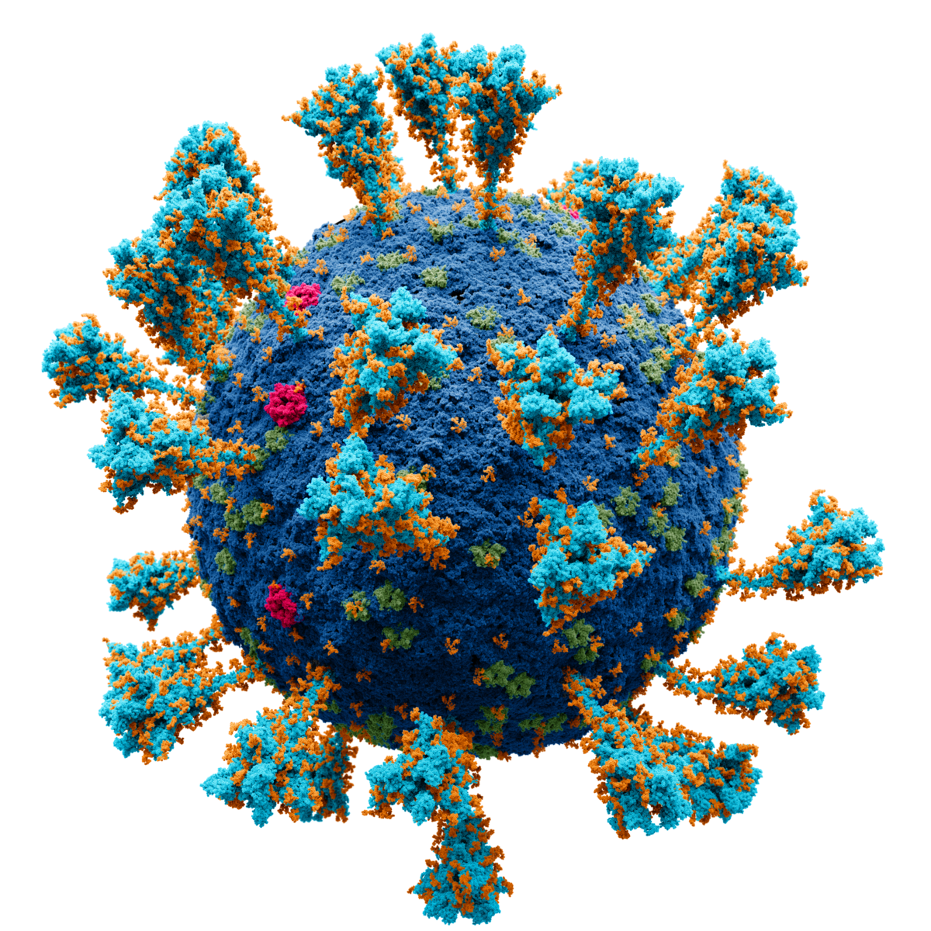

Los Angeles and COVID-19
Jadon Couch, Marla Blanco, Ryan Henkel

Slide 2


Background & Rationale
-Why and how did our team decide upon this topic?

Slide 3
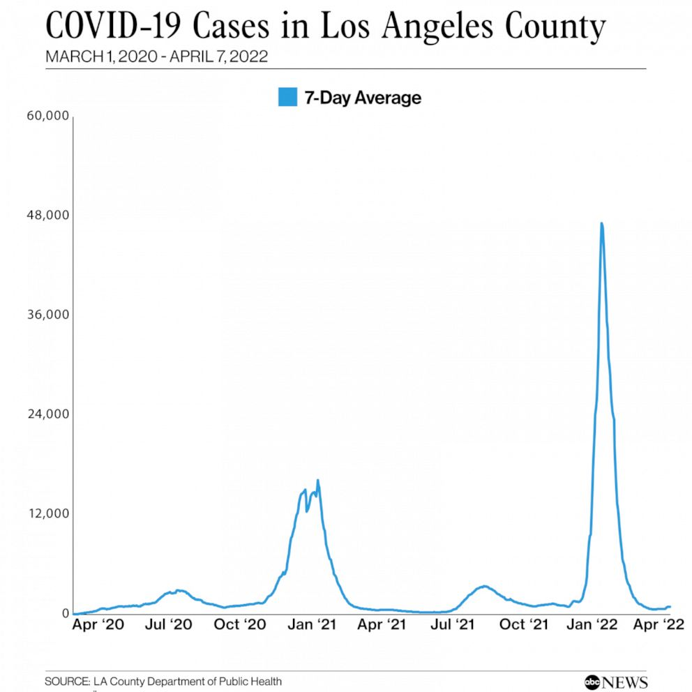
Our Project
-How did the COVID-19 pandemic affect the many different cities and neighborhoods in Los Angeles County?
-Why did some areas fare better than others? Did factors
such as median income or population density play a role
in how the pandemic affected Los Angeles?

Slide 4
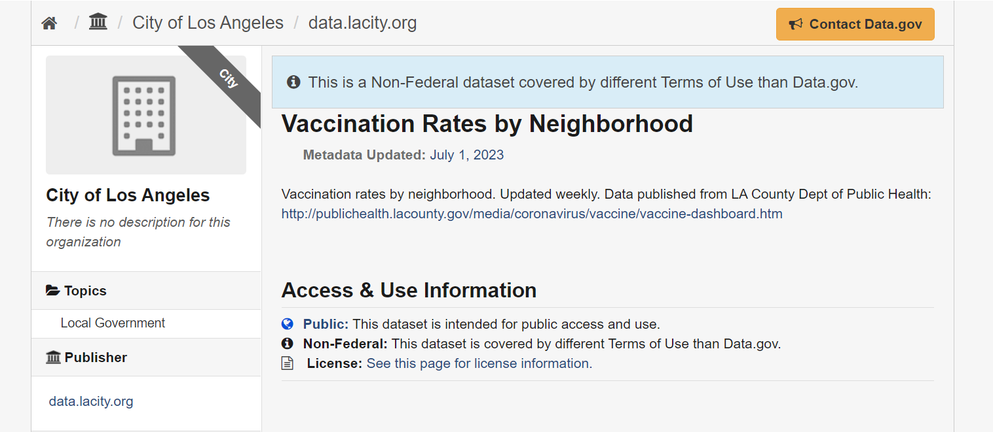
Collecting Our Data: COVID-19
Case rate, death rate, and vaccination rates for every neighborhood and city in Los Angeles County
Site: catalog.data.gov/dataset/vaccination-rates-by-neighborhood

Slide 5
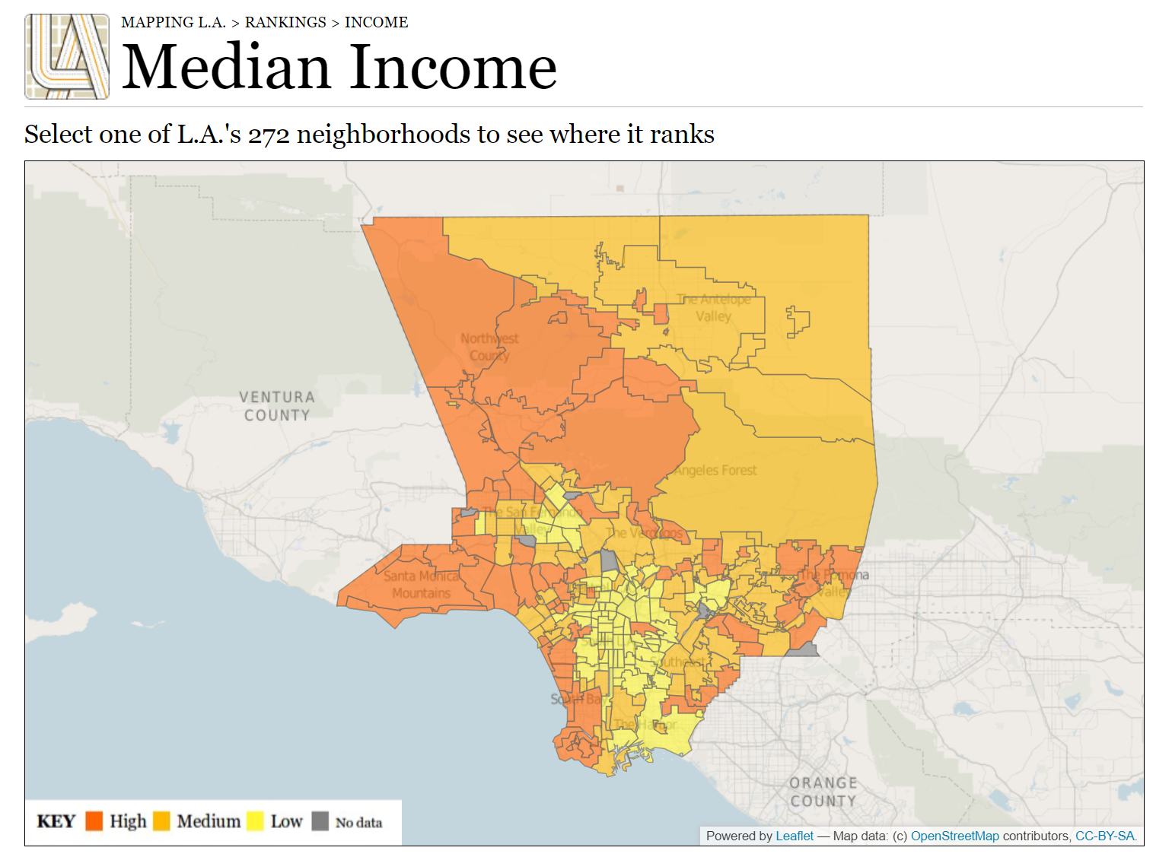
Collecting Our Data: Median Income
Median income of every neighborhood and city in Los Angeles County
Separated into ‘high’, ‘medium’, and ‘low’ classifications
Site: maps.latimes.com/neighborhoods/income/median/neighborhood/list/

Slide 6
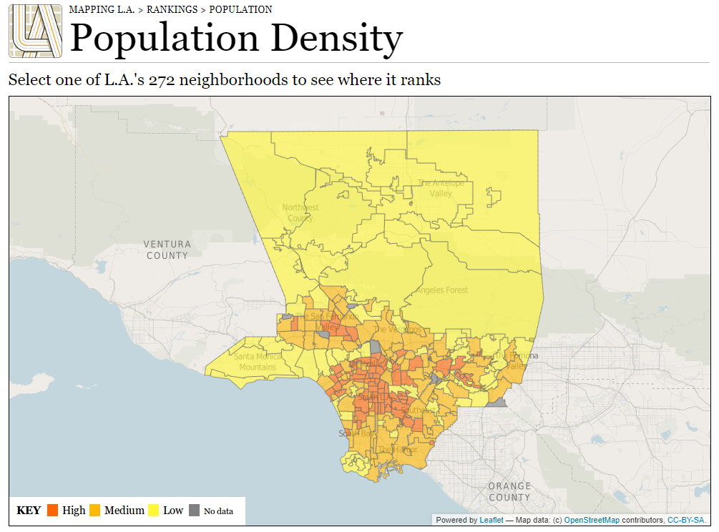
Collecting Our Data: Population Density
Population density of every neighborhood and city in Los Angeles County
Measures in population per square mile
Site: maps.latimes.com/neighborhoods/population/density/neighborhood/list/

Slide 7
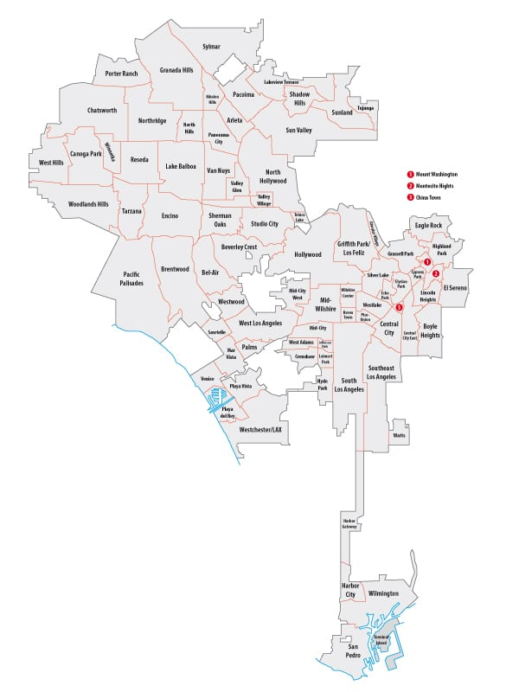
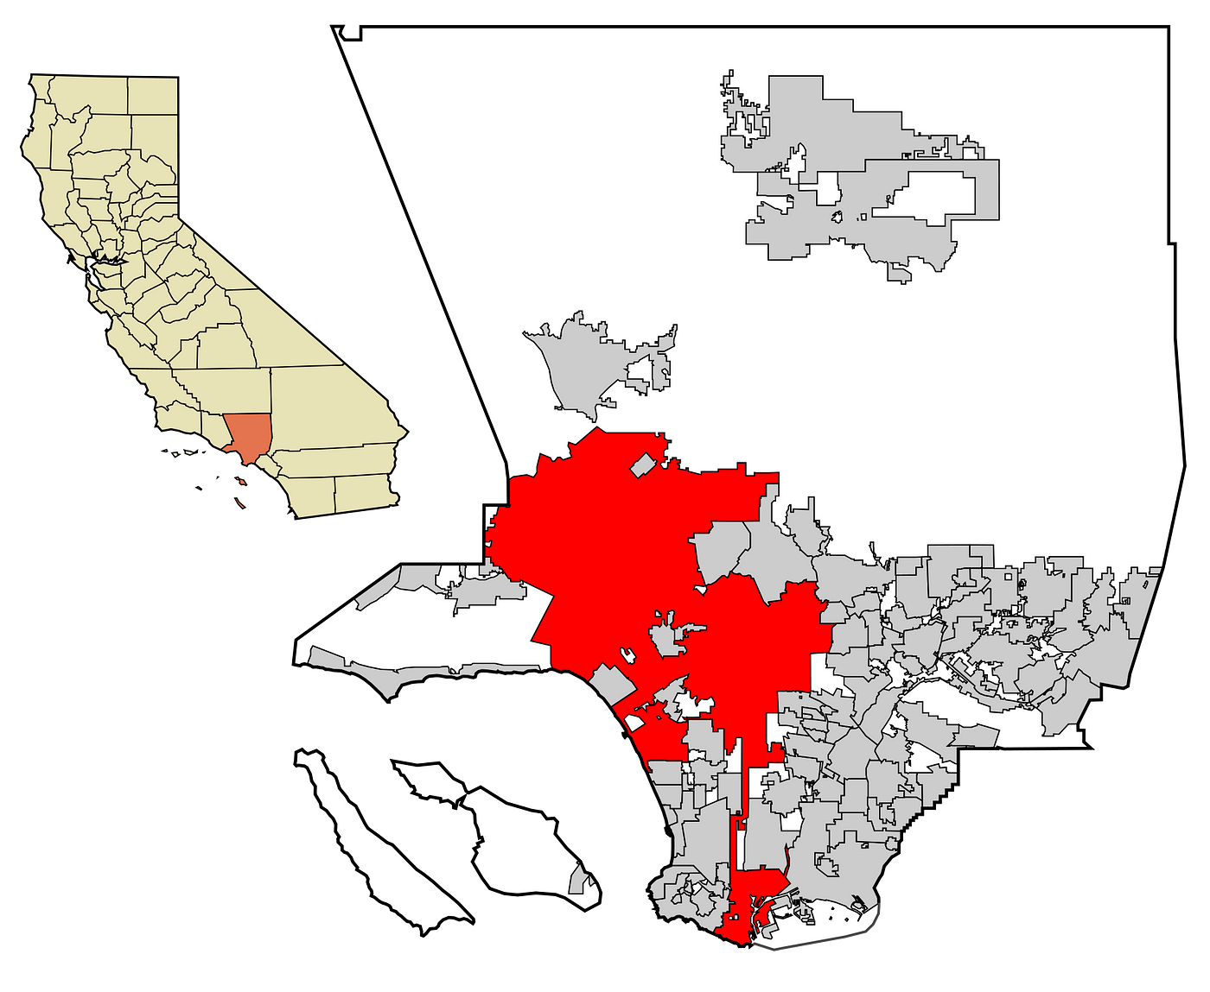
Data/Cleaning & Roadblocks

Slide 8
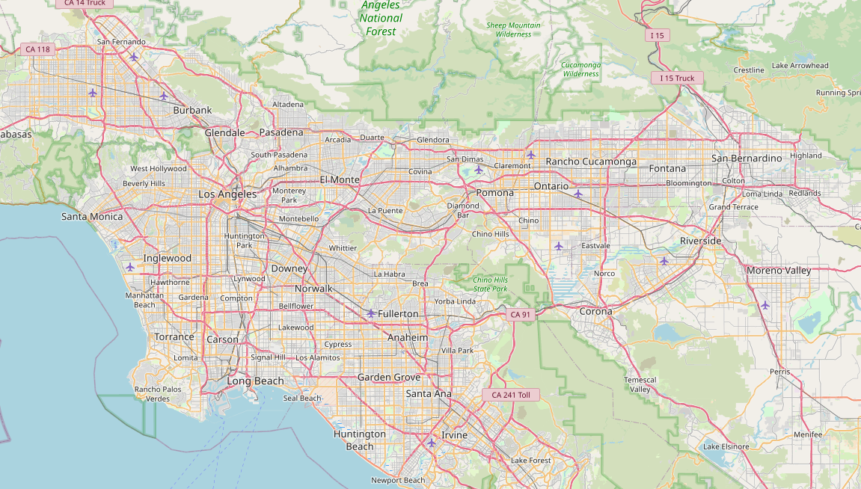
The API: Open Street Map
Open Street Map is a free to use API (No API Key Needed).
By making a request with the name of a city or neighborhood in LA, we were able to get the Lat and Lon of that city of neighborhood
Site: openstreetmap.org

Slide 9
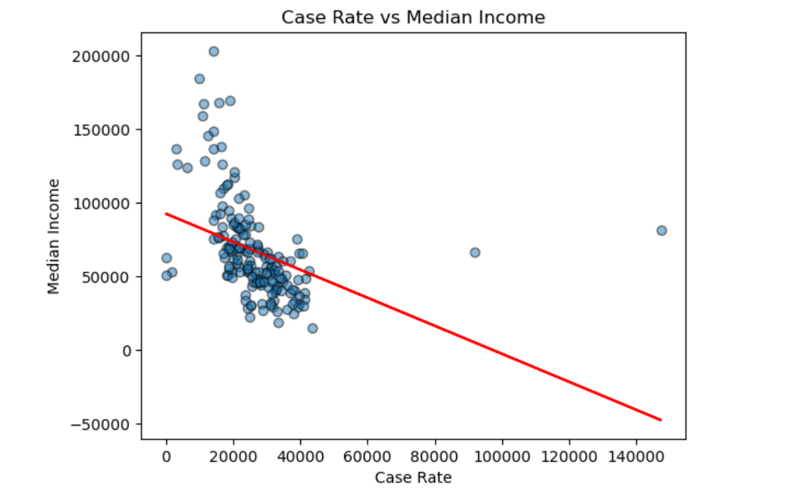
Median Income / Overall Case Rate
Correlation coefficient (r): -0.38
p-value: 1.16e-07

Slide 10
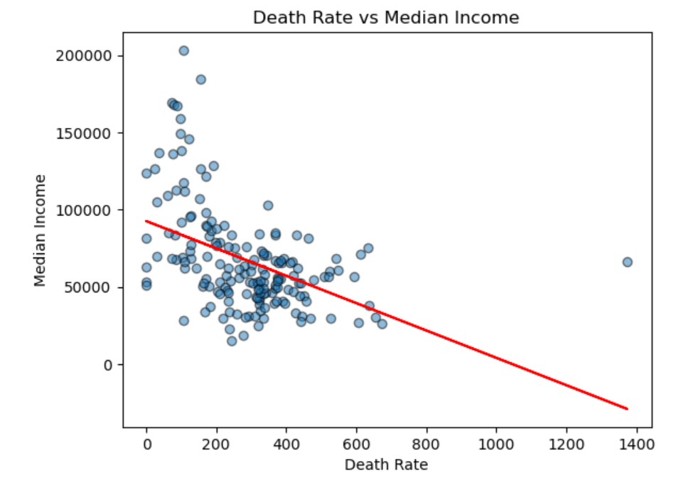
Median Income / Death Rate
Correlation coefficient (r): -0.45
p-value: 6.65e-10

Slide 11
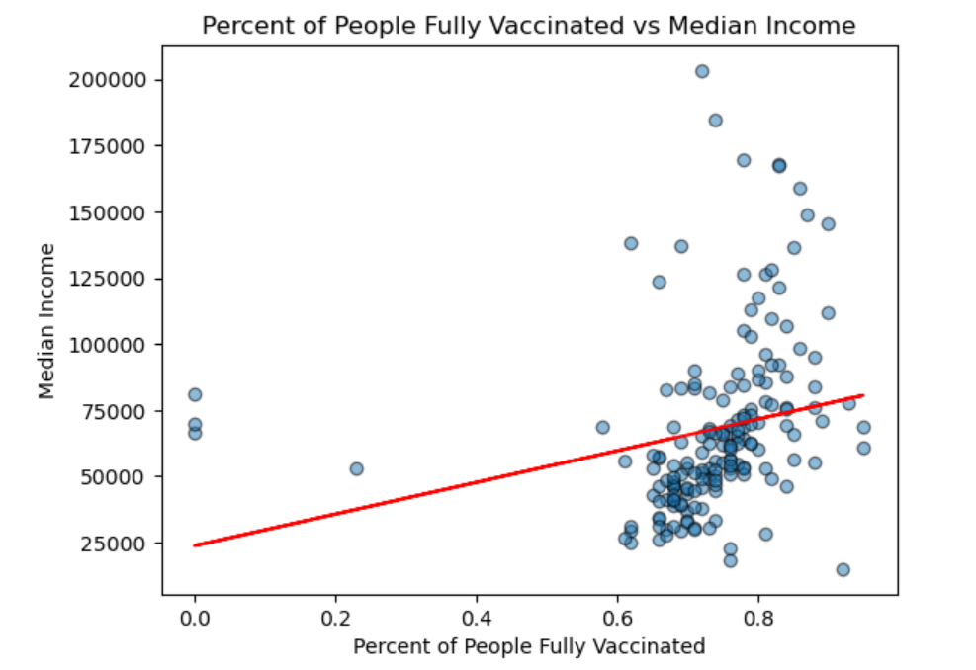
Median Income / Vaccination Rate
Correlation coefficient (r): 0.23
p-value: 0.003

Slide 12
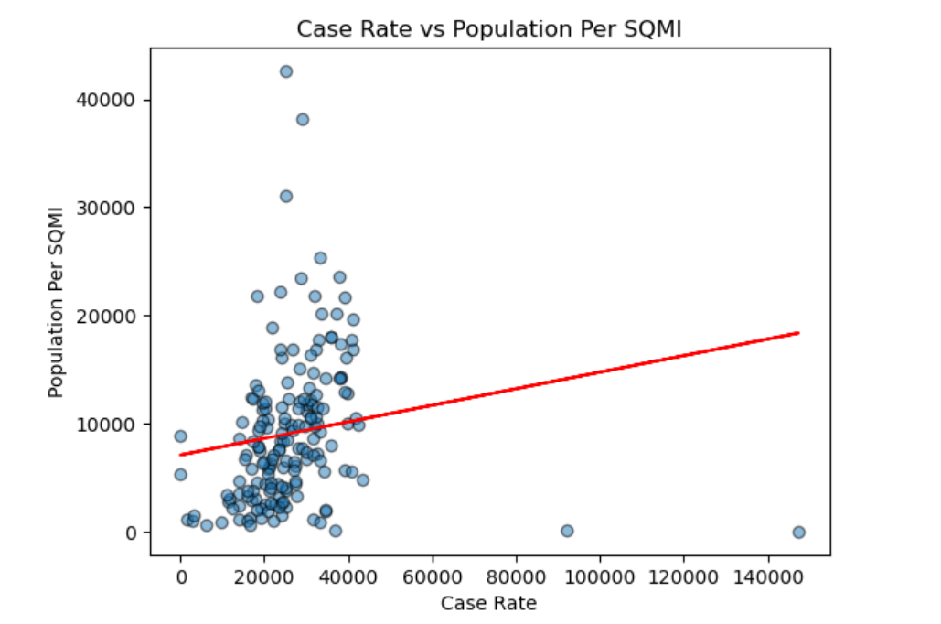
Population Density / Overall Case Rate
Correlation coefficient (r): 0.15
p-value: 0.04

Slide 13
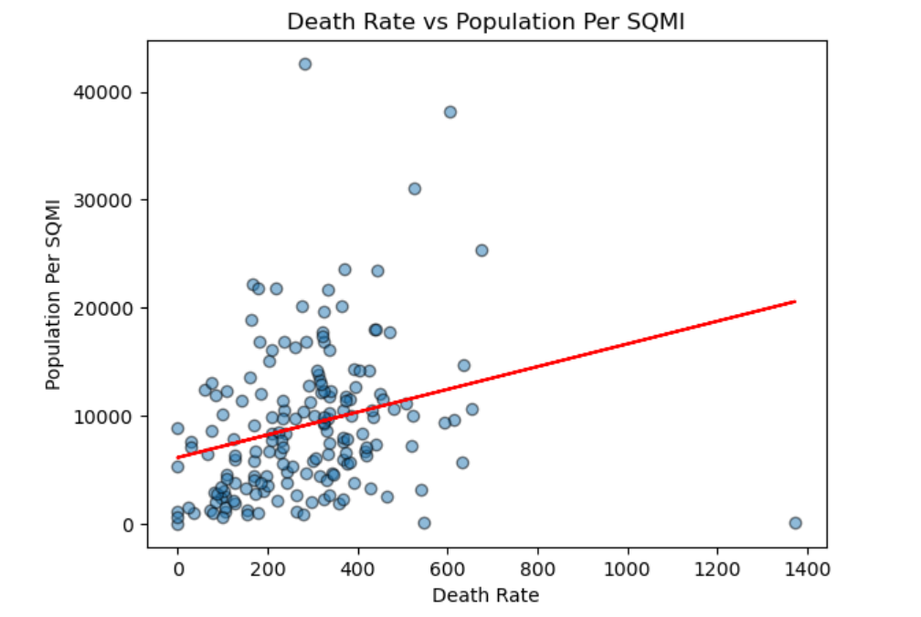
Population Density / Death Rate
Correlation coefficient (r): 0.26
p-value: 0.0005

Slide 14
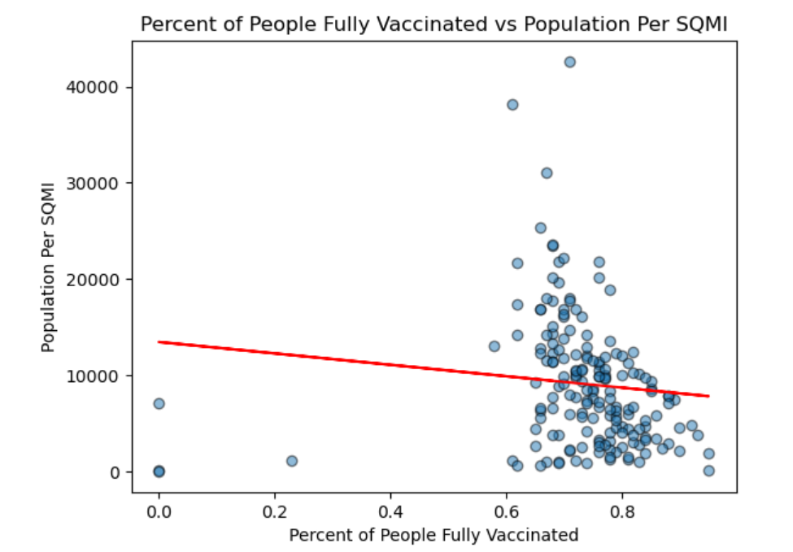
Population Density / Vaccination Rate
Correlation coefficient (r): -0.11
p-value: 0.15

Slide 15
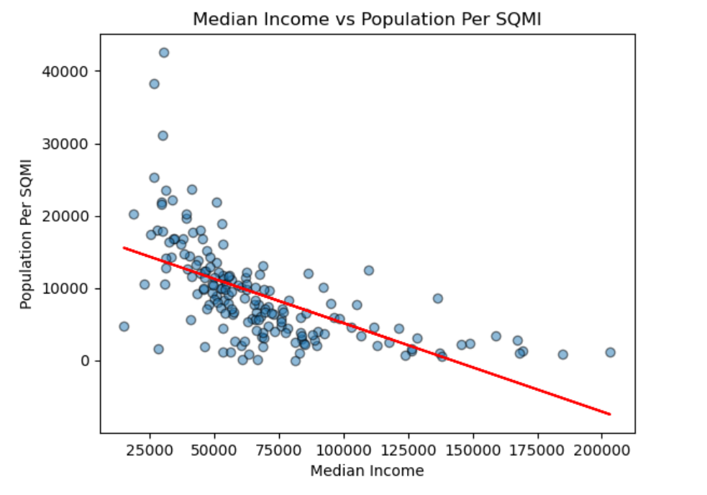
Median Income / Population Density
Correlation coefficient (r): -0.60
p-value: 3.51e-18

Slide 16
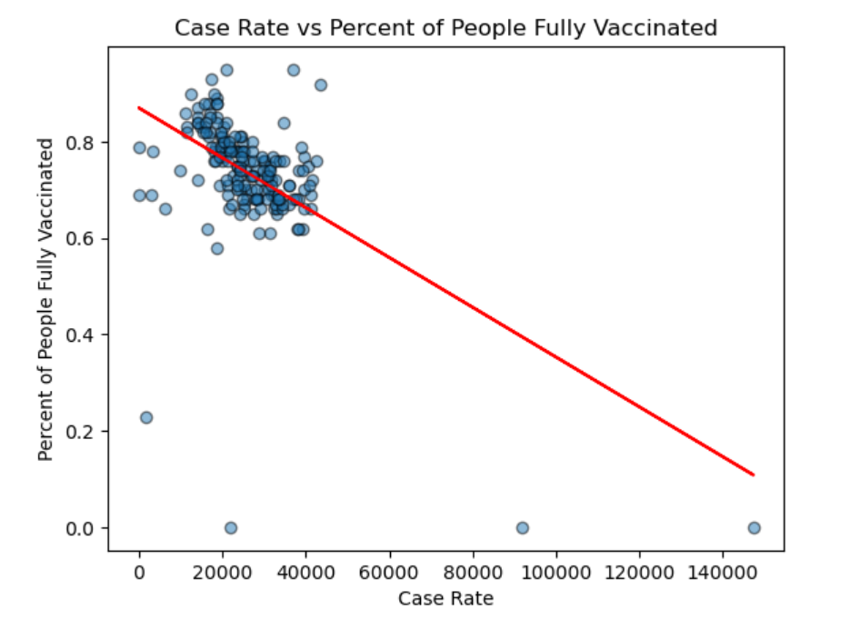
Vaccination Rate / Overall Case Rate
Correlation coefficient (r): -0.56
p-value: 2.29e-15

Slide 17
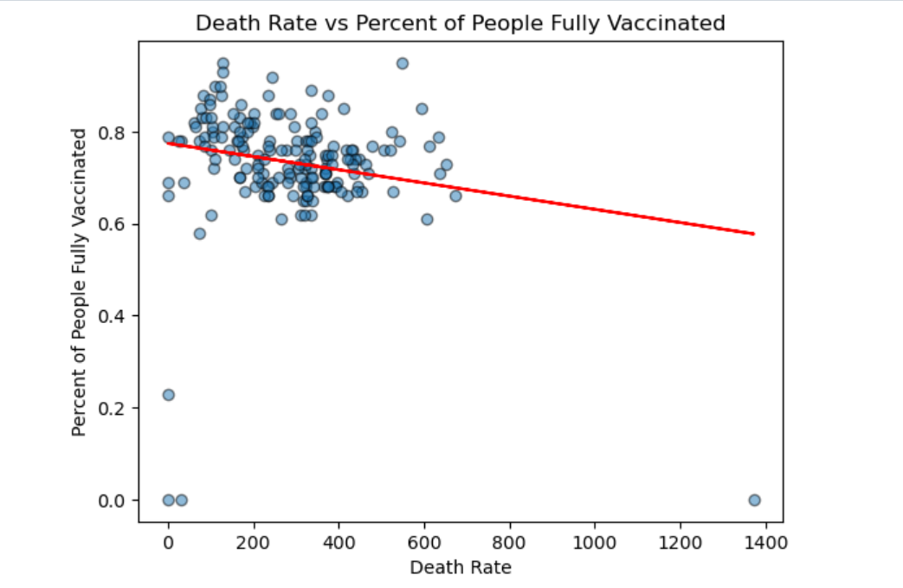
Vaccination Rate / Death Rate
Correlation coefficient (r): -0.19
p-value: 0.01

Slide 18
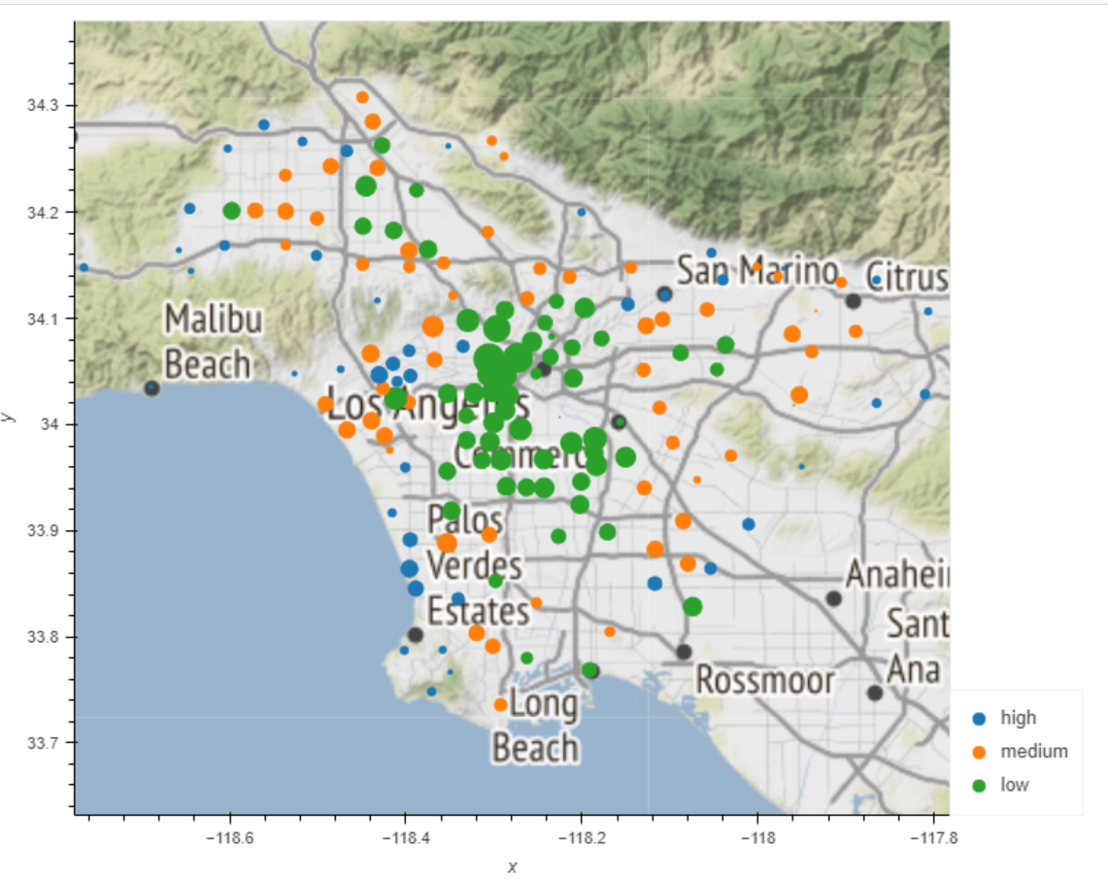
Population Map
Dot Color = Income Level
Bigger Dot = Higher Population

Slide 19
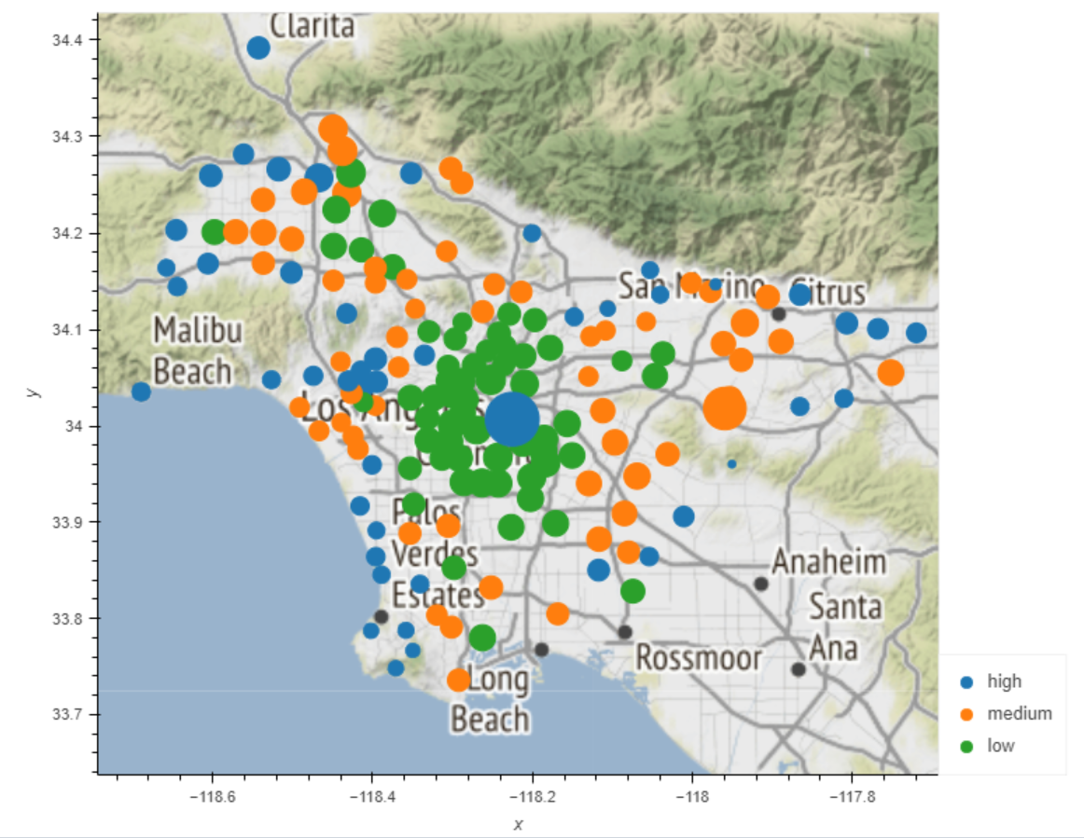
Case Rate Map
Dot Color = Income Level
Bigger Dot = More Cases

Slide 20
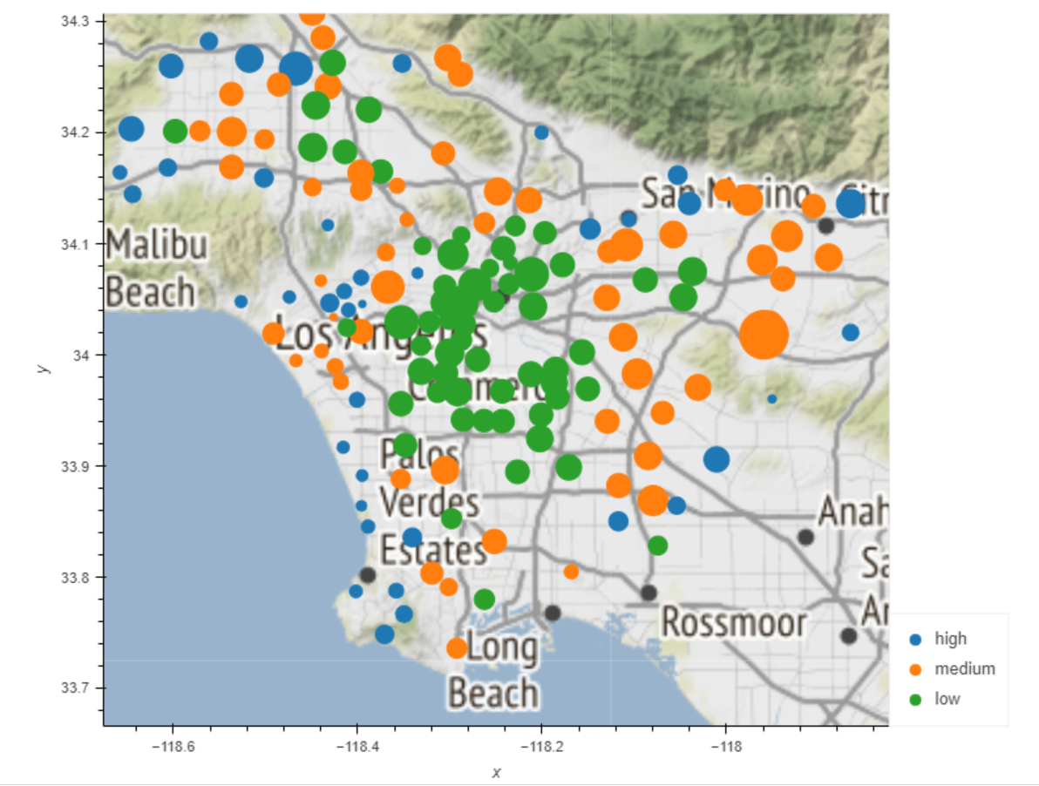
Death Rate Map
Dot Color = Income Level
Bigger Dot = More Deaths

Slide 21
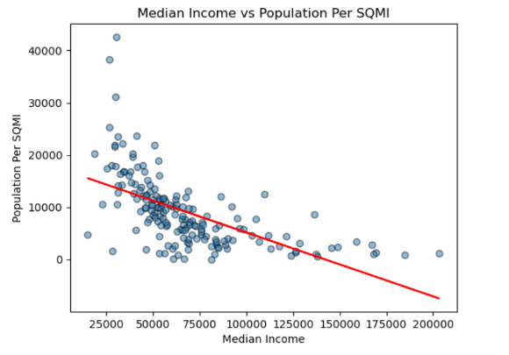

Analysis
-So, what did we discover about how COVID-19 affected different Los Angeles neighborhoods?

Slide 22
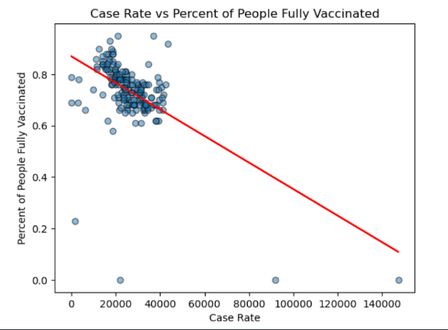

Analysis
Death Rate

Slide 23
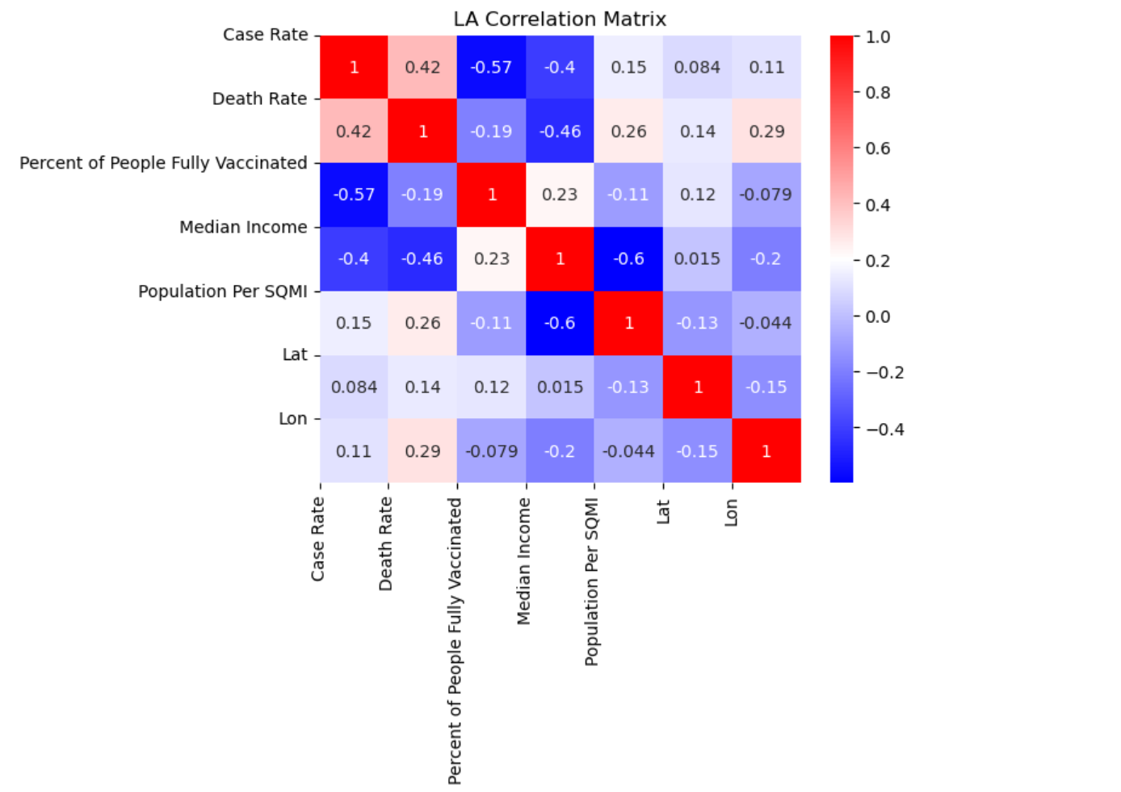
Correlation Matrix

Slide 24

Conclusion / Questions

